Slide 1


Social Buzz

Slide 2


Today's agenda
Project recap
Problem
The Analytics team
Process
Insights
Summary

Slide 3

Social Buzz was founded by two former engineers from a large social media conglomerate.
Social Buzz has reached over 500 million active users each month.
Huge amounts of data over 100,000 pieces of content, ranging from text, images, videos and GIFs are posted.
Why this assignment was reached out by Social Buzz:
IPO by the end of next year
Need of assistance
Learning from the best data analytics practices
Our 3 months program include:
- An audit of their big data practice
- Recommendations for a successful IPO
- An analysis of their content categories that highlights the top 5 categories with the largest aggregate popularity.
Project Recap

Slide 4

Problem
Analysis of their content categories that highlights the top 5 categories with the largest aggregate popularity.

Slide 5



Andrew Fleming (Chief Technical Architect)
The Analytics team
Marcus Rompton (Senior Principle)
Ashik Jayan
(Data Analyst)

Slide 6
Process
1
Requirements gathering
2
Data cleaning
3
Data modelling
A cleaned dataset containing all the required columns
4
5
Analysed Top 5 categories

Slide 7

Insights
Photos are the most common media used
Travel category, people reacts the most
Posts in July is the lowest

Slide 8
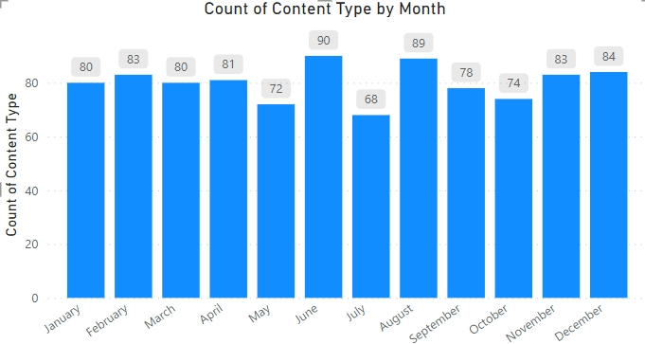

Slide 9
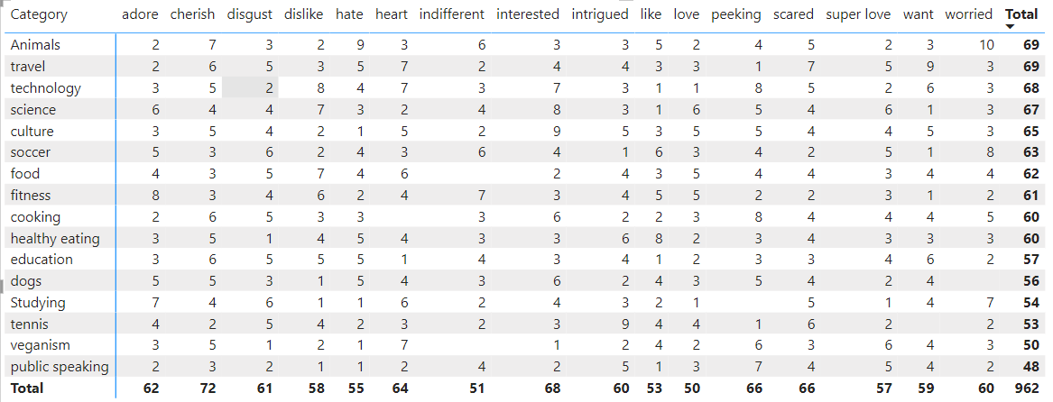

Slide 10

Travel and Culture are the most popular categories of content, in which Photos are used as the main mode of posting these contents.
June and August are the months were post people are posting the contents
The emotions like Cherish, Interested, Scared and Peeking are used the most.
Technology has been on the rise and need for advanced techniques.
Summary

Slide 11
Thank you!
ANY QUESTIONS?

